Slide 1
St Mary’s NS, Oldtown
Junior Infants
Information Booklet

Slide 3
Welcome
Dear Parents,
I would like to welcome you all to St Mary’s NS, Oldtown. This booklet is intended to give you some information which I hope you find useful over the coming weeks. We look forward to having your child start their educational journey with us this September and can assure you we will support them every step of the way. I look forward to working with you all over the coming years.
Ms Kirwan

Slide 4
UNIFORM
Our school uniform consists of a grey pinafore/ grey trousers, a blue shirt and a grey jumper or cardigan. Tights or socks can be worn with the pinafore.
Our school tracksuit consists of grey trousers and a grey jumper with a yellow stripe down the side and a yellow polo t-shirt.
Children can decide whether to wear the uniform or the school tracksuit on a daily basis. We do not mind, so long as they are in one of them! Most of our children choose to wear the tracksuit every day.
Uniforms can be purchased at Pat O’Farrell School Wear, Unit 2, N1 Business Park, Swords or at https://www.ofarrellschoolwear.com/ .
**We are completely changing our uniform in September 2024 and it is envisaged that this will happen over a 2 year rolling period. Please keep this in mind when purchasing the uniform this year.

Slide 5
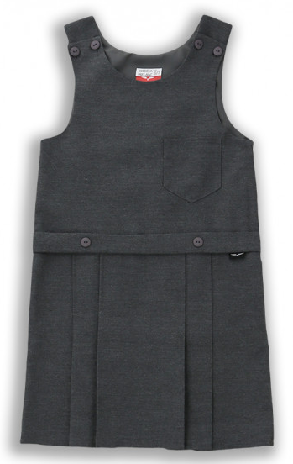
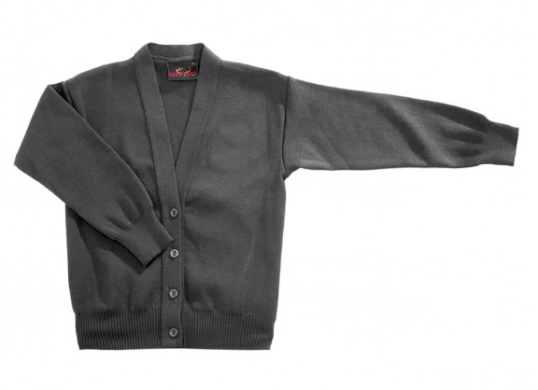
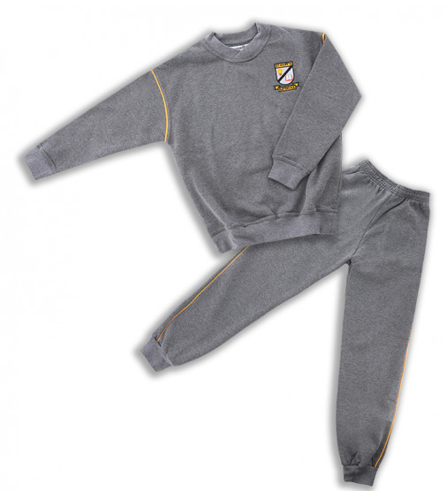
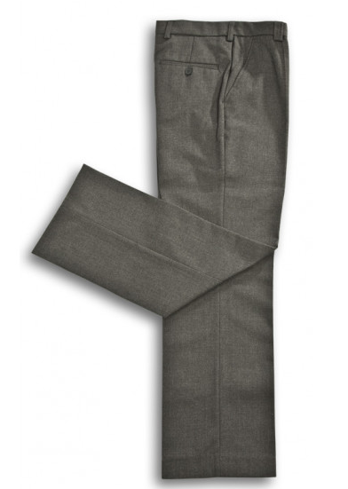
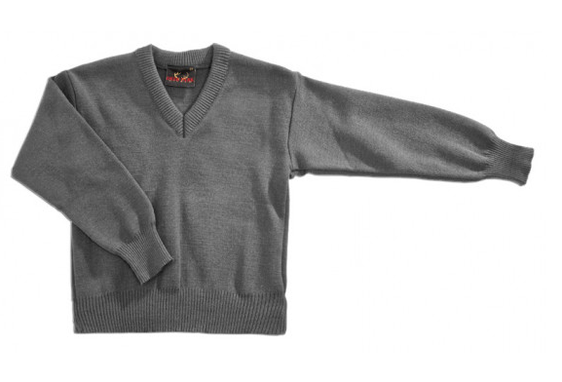
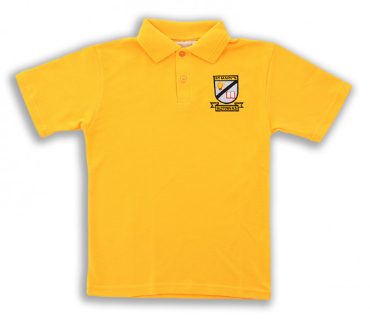

Slide 6
To Buy
From September 2023, schools are supplying all books needed for your child so you do not need to worry about purchasing any.
We ask that you do purchase a school bag large enough to hold an A4 folder, a pencil case containing pencils, a rubber, a parer and colouring pencils (please ensure everything is labelled), a lunch box and a water bottle.

Slide 7
School Services
We ask all families to please pay the school service charge at the beginning of each school year if possible. The cost of school services for children in Junior Infants is €75 which includes school insurance through Allianz. School Insurance covers the children 24 hours a day, 7 days a week. The school service money goes towards the following:
Insurance
Photocopying
Art and Craft materials
Spare pencils, parers etc
Folders
Scrapbooks
Digital resources
Extra curricular activities

Slide 8
We have a very active Parent’s Association here in St Mary’s. The Parent’s Association run fantastic fundraising events throughout the year to raise money for the school. ALL of this money goes towards the children. Last year, the whole school attended swimming lessons which was mostly subsidised by the funds raised by the PA. If you would like to find out more about the Parent’s Association, or are looking to be involved, please contact Teresa in the office and she will put you in touch with the current chairperson, Sandra Keely.

Slide 9
Office
Teresa Smith is our much loved secretary! She can be found in the office on Mondays, Thursdays and Fridays from 8:30 – 12:30. (She can be found on the golf course outside of these times). If you are ringing outside of these times, please leave a message on the answering machine and someone will get back to you as soon as they can.

Slide 10
Contact and Communication
We communicate with parents mostly via email. Our email address is oldtownns@gmail.com. Please ensure the school has an up-to-date email address for you! Information can also be found on our website, Facebook and Instagram. We use Facebook quite frequently to share photos of what the children are getting up to in school.
Phone: 01-8432060
Website: www.oldtownns.ie
Facebook: Oldtown National School
Instagram: oldtown_n.s

Slide 11
A Day in the Life of a Junior Infant Ms Comer
I know every parent will ask their child ‘What did you do in school today?’ and the usual answer you get is ‘nothing’, but I can assure you that is not true :) Here is a little overview of a typical day in Junior Infants.
When the children leave you in the morning they come to their line. Chances are it is a race to get the bag down on the line and then run over quickly to see what their friends are up to! Drop off time is between 8:50 and 9am. Children have a few minutes, supervised by a staff member, on yard during this drop-off time. The bell rings at 9, they line up and wait for their teacher to greet them and bring them into their classroom.
Junior Infants are in the same room as Senior Infants. The Infants curriculum is very hands on, fun and they will learn a lot through guided discovery and getting stuck in. When they tell you all they did was play, there is purpose to this ‘play’!

Slide 12
Each morning we focus on Aistear, English and Maths. One lovely part of the infants curriculum is Aistear.
Then it is time for a well deserved snack break. Our little break is usually our fruit break, the children get lots of time to eat their snack and then it is time to go out and play for our 15 minute yard! The infants play on the soft play area outside and have a variety of outside equipment to keep them entertained and have fun with their friends.
After yard we cover a wide range of subjects such as Irish, SESE, PE and Art to name a few. We cover a range of activities in these subjects and you usually will find us colouring, writing, reading, playing games, dancing, cutting or sticking something. We also have a lovely interactive whiteboard (or the ‘big TV’ which it is commonly named) which enhances lessons and lets us explore our subjects!
Then it is lunch time, we say our prayers and take out our lunch. After eating, we go outside for our ‘big yard’ break! When we come back in we have just enough time for some oral language lessons or a story before the children pack up and are back with you :)

Slide 13
Subjects
.
Irish
English
Maths
Geography
History
Science
Art
Drama
Music
SPHE
PE
Religion
*Aistear

Slide 14
Aistear
Aistear is the Irish word for journey. This
is play based learning that allows the children to learn and explore through play! Aistear plays an important role in the Infants curriculum. Aistear usually has a different theme each month (e.g. Space) and will be based on what the children are learning in class. It integrates a lot of subjects – English, maths,
art, drama, music etc.
through role play and
Small World games

Slide 15
Homework
Junior Infants get a small amount of homework each night. This is usually an activity based on the sound they are learning in class and/ or a maths activity! It will always be something they have covered in class that week. We highly recommend that you read to your child daily and cannot emphasise the importance of this. Informal conversation about the story is a fantastic way to explore how their mind is working. As time goes on, they will be able to point out letters and sounds that they recognise. In no time at all, they will be reading to you!

